Slide 1
Programming Best Practices
Presented By Raafat H

Slide 2
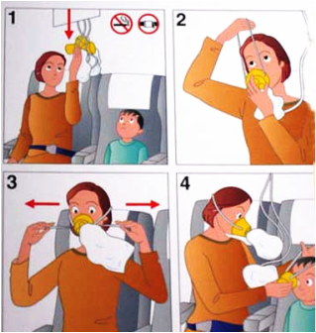
Help Yourself First!
Source:https://eyf2014.wordpress.com/2013/09/02/take-care-of-yourself/

Slide 3

https://www.ucl.ac.uk/students/news/2020/apr/10-benefits-helping-others

Slide 4
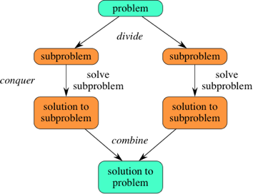
Divide-and-conquer is my favourite!
Source:https://eyf2014.wordpress.com/2013/09/02/take-care-of-yourself/

Slide 5
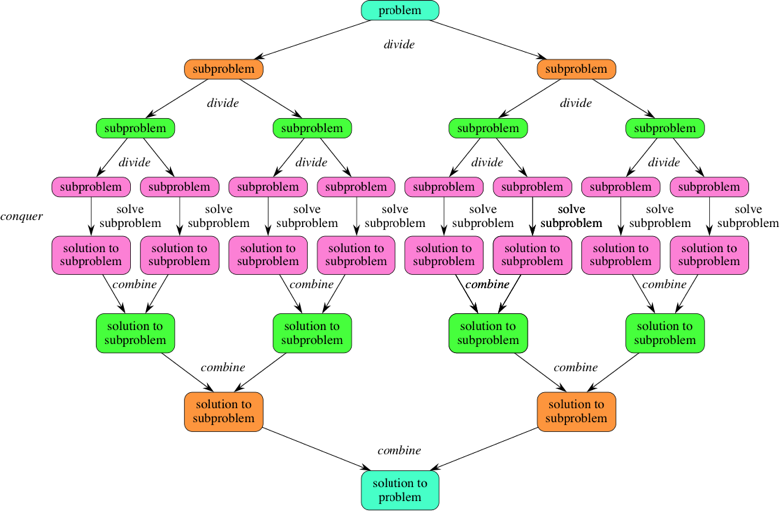
Divide-and-conquer
Source:https://eyf2014.wordpress.com/2013/09/02/take-care-of-yourself/

Slide 6

Sorry...

Slide 7
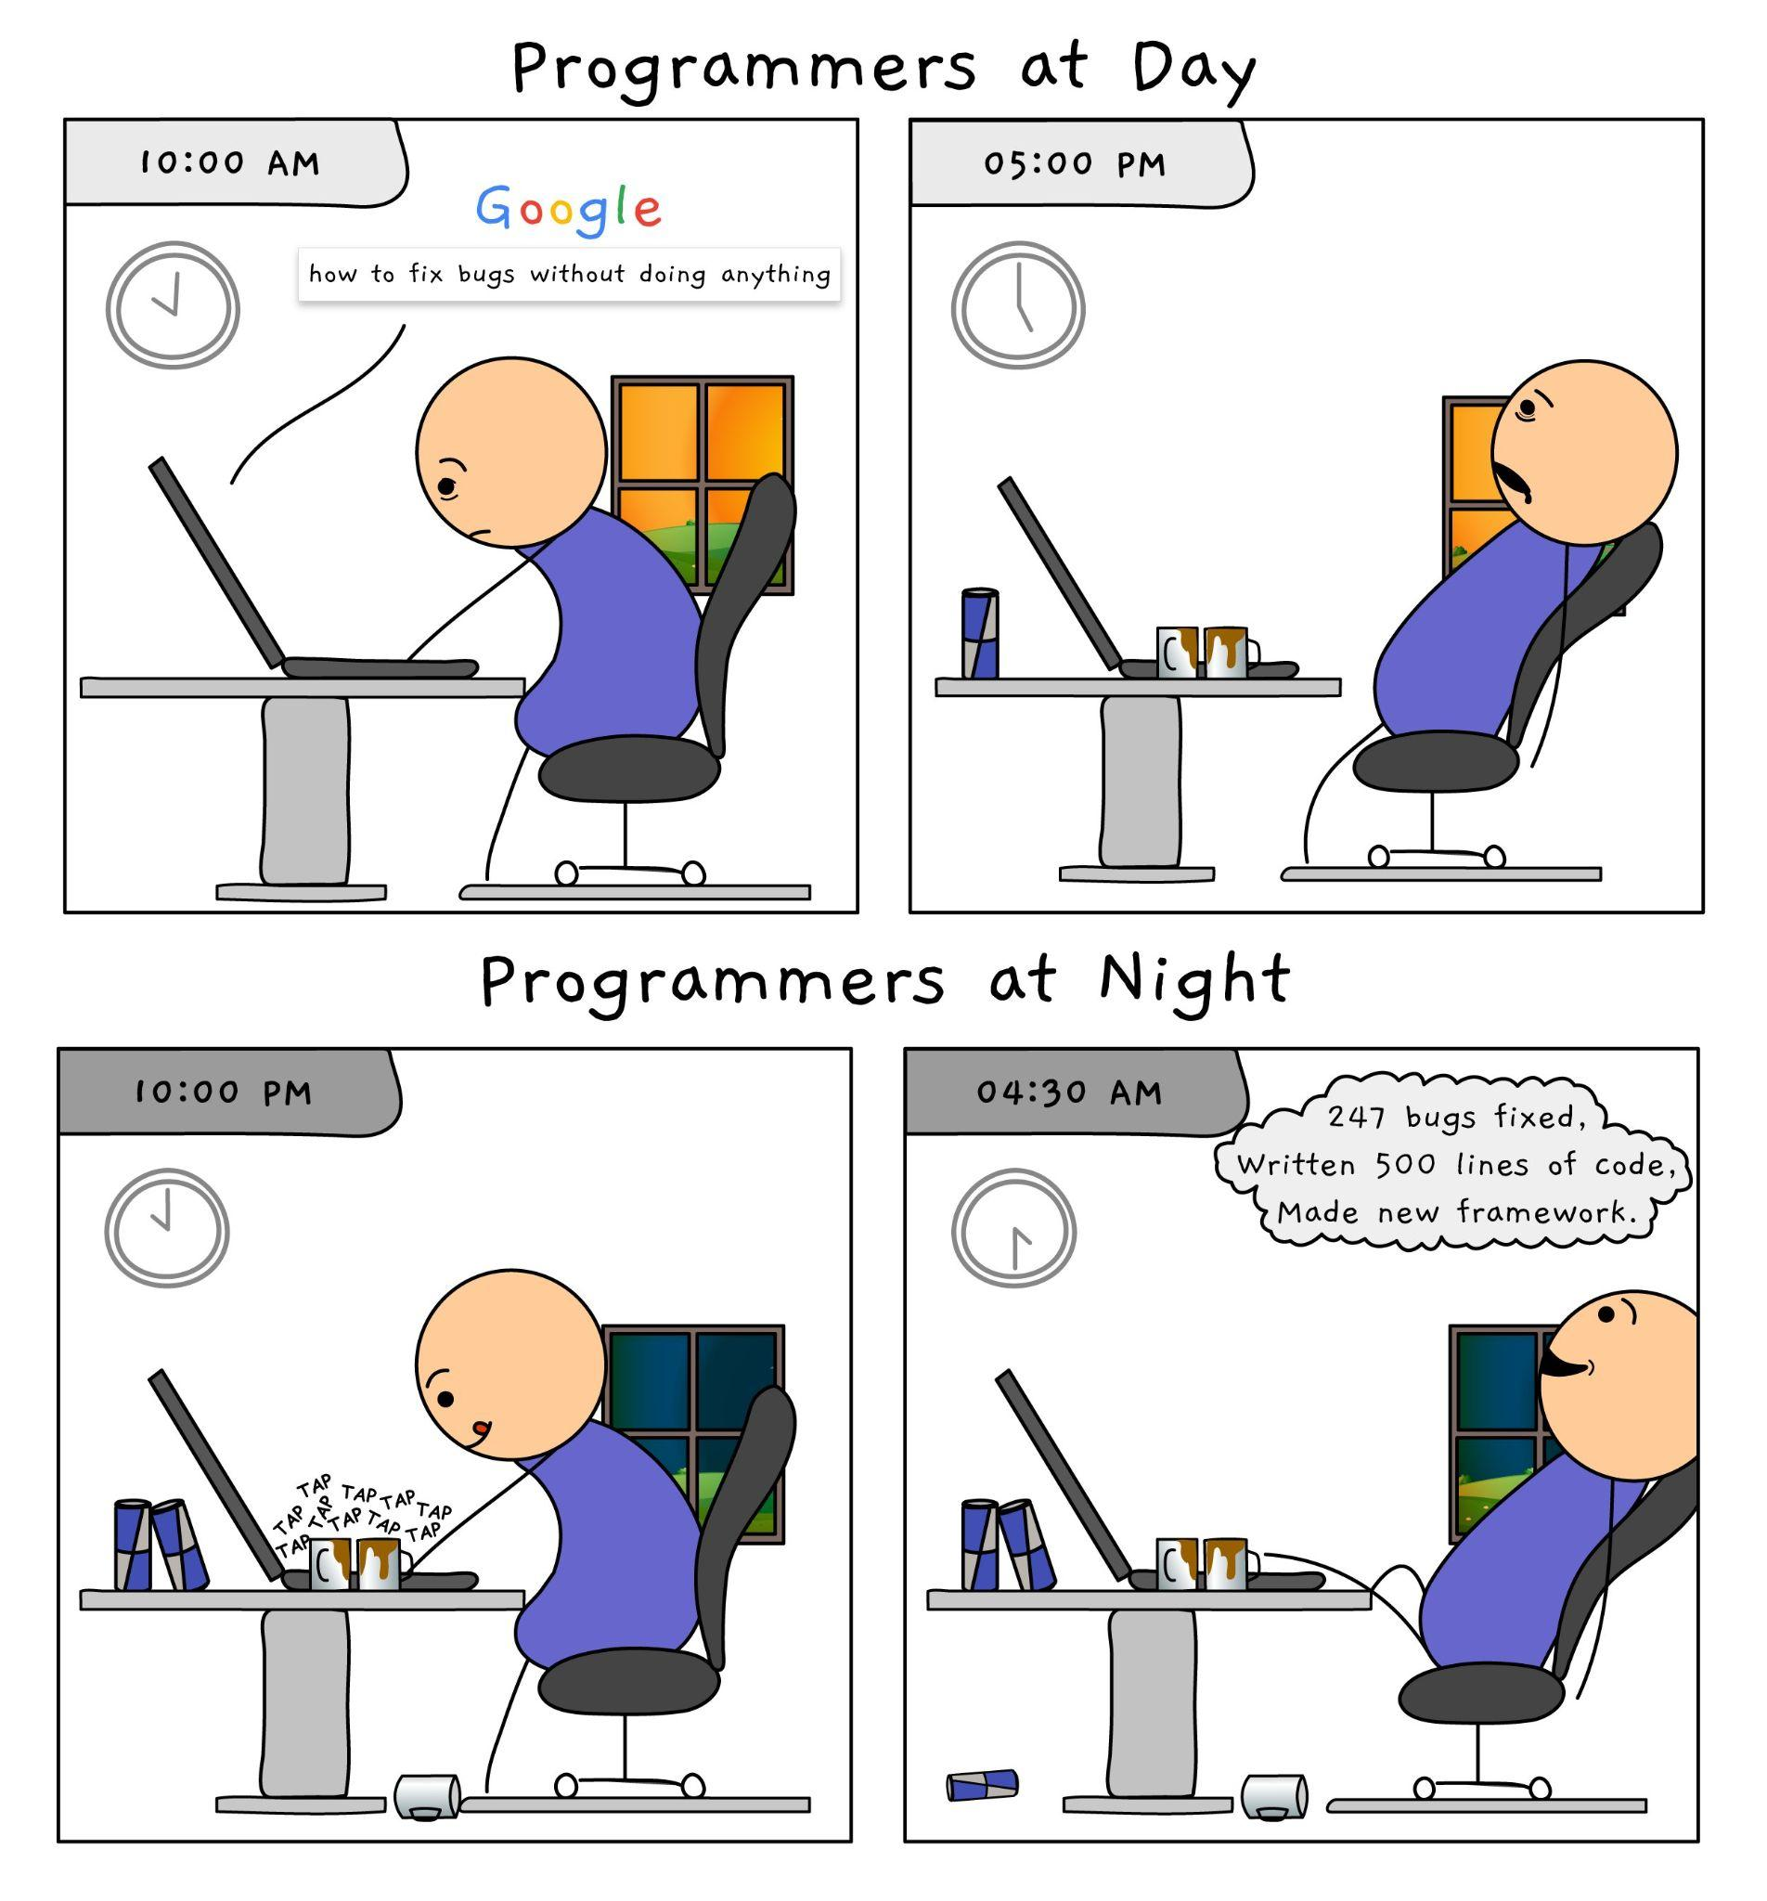
No shortcuts
source:https://twitter.com/techindustan

Slide 8

Source:https://eyf2014.wordpress.com/2013/09/02/take-care-of-yourself/

Slide 9
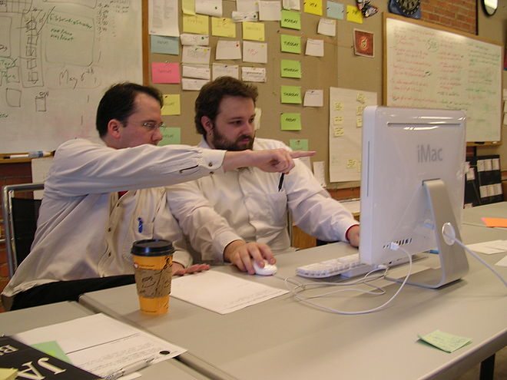
Pair Programming
Boost the overall productivity
Source:https://eyf2014.wordpress.com/2013/09/02/take-care-of-yourself/

Slide 10
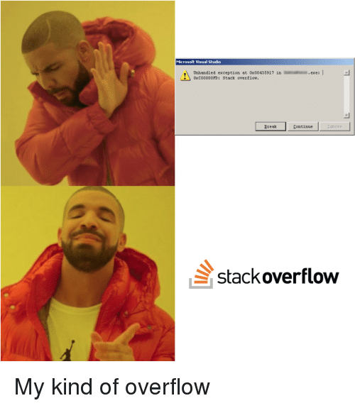
Stackoverflow is your best friend.
Source:https://codeburst.io/stack-overflow-programmers-best-friend-ef77e4d142c4

Slide 11
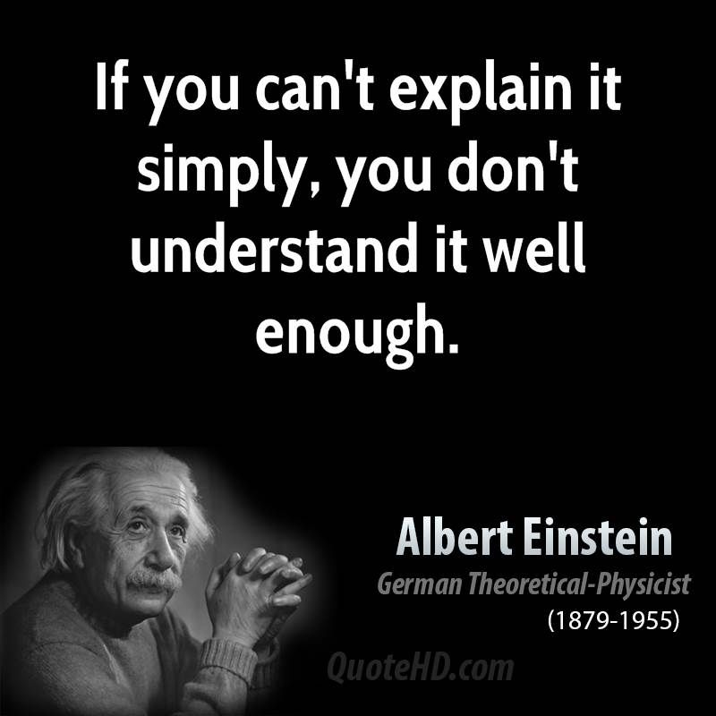
Understand your problem.

Slide 12
Ask the right question
https://www.freecodecamp.org/news/how-to-ask-good-questions-as-a-developer-9f71ff809b63/
https://stackoverflow.com/help/how-to-ask

Slide 13
Googling is a skill
http://www.agoogleaday.com/

